Slide 1
Diffusion models

Slide 2
Outline
Problem statement
Diffusion model theory (a bit mathy!) – Maybe skip
Our implementation
Outlook

Slide 3
Problem introduction
Investigate RWGS: CO₂ + H₂ ⇌ CO + H₂O on metallic alloys
Example: 111-surface with only 4 active sites
Element pool of 3 yields 3.5billion conf.
Approximation: Ignore effect of stability/geometrical DOF’s.
Swap elements
Reaction rate
Brown: site atoms
Yellow: neighbor atoms

Slide 4
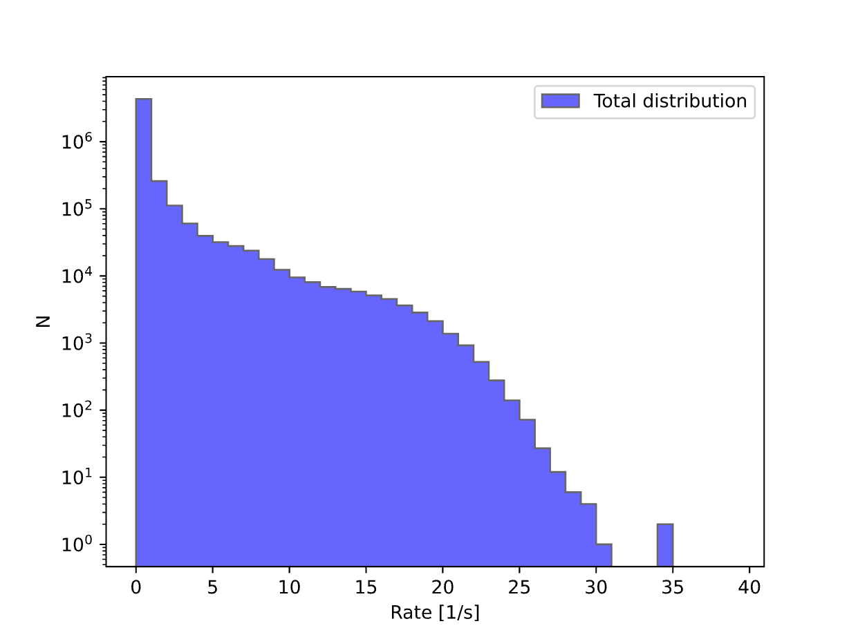
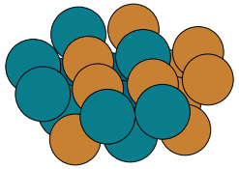
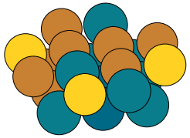
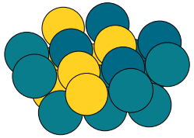
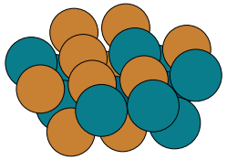
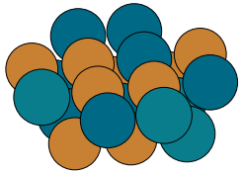
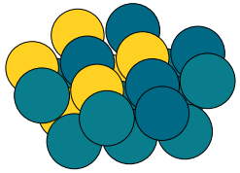
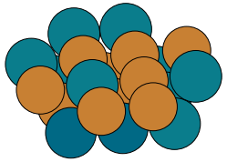
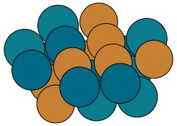
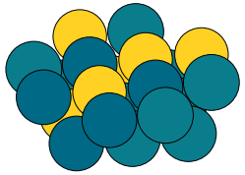









Rates from random sampling
{Rh,Cu,Pd}
{Rh,Cu,Au,Pd}
{Rh,Pd,Au}
$$R=\text{34.4}\text{2 [1/}\text{s}\text{]}$$
$$R=\text{25.5}\text{9[1/}\text{s}\text{]}$$
$$R=\text{1.4}\text{1[1/}\text{s}\text{]}$$
$$R=\text{34.}\text{33 [1/}\text{s}\text{]}$$
$$R=\text{23.5}\text{9[1/}\text{s}\text{]}$$
$$R=\text{1.38}\text{[1/}\text{s}\text{]}$$
$$R=\text{3}\text{0}\text{.}\text{39 [1/}\text{s}\text{]}$$
$$R=\text{23.4}\text{9[1/}\text{s}\text{]}$$
$$R=\text{1.34}\text{[1/}\text{s}\text{]}$$

Slide 5

Rates from random sampling
{Rh,Cu,Pd}
{Rh,Cu,Au,Pd}
{Rh,Pd,Au}
$$R=\text{34.4}\text{2 [1/}\text{s}\text{]}$$
$$R=\text{25.5}\text{9[1/}\text{s}\text{]}$$
$$R=\text{1.4}\text{1[1/}\text{s}\text{]}$$
”Generate structures with rates 25/s”
$$R=\text{34.}\text{33 [1/}\text{s}\text{]}$$
$$R=\text{23.5}\text{9[1/}\text{s}\text{]}$$
$$R=\text{1.38}\text{[1/}\text{s}\text{]}$$
$$R=\text{3}\text{0}\text{.}\text{39 [1/}\text{s}\text{]}$$
$$R=\text{23.4}\text{9[1/}\text{s}\text{]}$$
$$R=\text{1.34}\text{[1/}\text{s}\text{]}$$

Slide 6
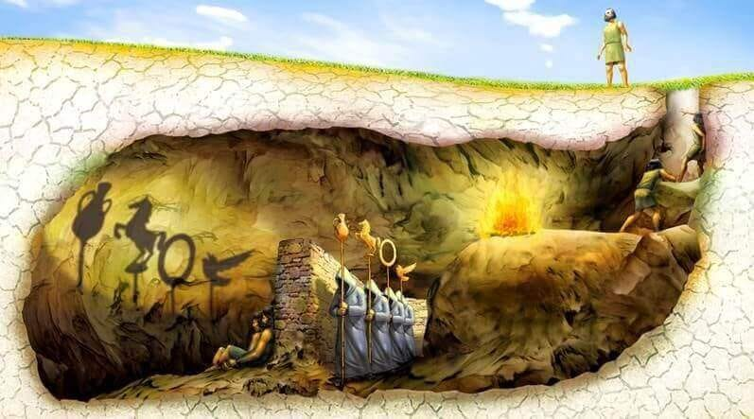
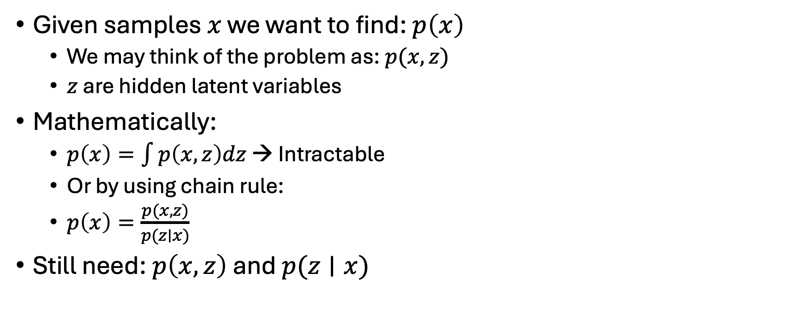
Diffusion model theory
Given samples $x$ we want to find: $p\left(x\right)$
We may think of the problem as: $p(x,z)$
$z$ are hidden latent variables
Mathematically:
$p\left(x\right)=\int{p\left(x,z\right)dz}$ → Intractable
Or by using chain rule:
$p\left(x\right)=\frac{p(x,z)}{p(z∣x)}$
Still need: $p\left(x,z\right)$ and $p(z∣x)$

Slide 7
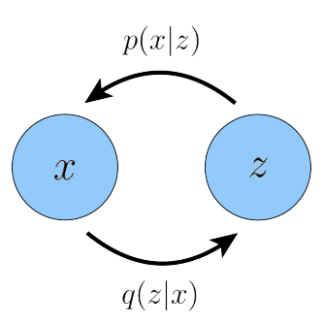
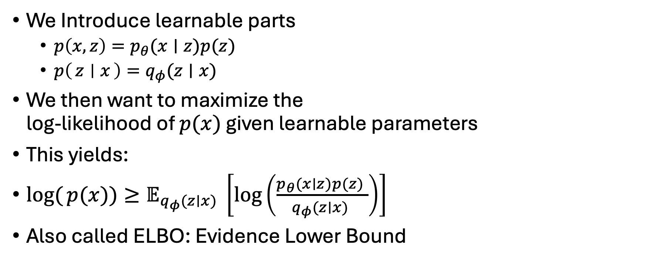
Diffusion model theory
We Introduce learnable parts
$p\left(x,z\right)=p_{θ}(x∣z)p(z)$
$p\left(z ∣ x\right)=q_{φ}(z∣x)$
We then want to maximize the log-likelihood of $p(x)$ given learnable parameters
This yields:
$log({p(x))}≥𝔼_{q_{φ}(z∣x) }\left[log⁡\left(\frac{p_{θ}(x∣z)p(z) }{q_{φ}(z∣x) }\right)\right]$
Also called ELBO: Evidence Lower Bound

Slide 8
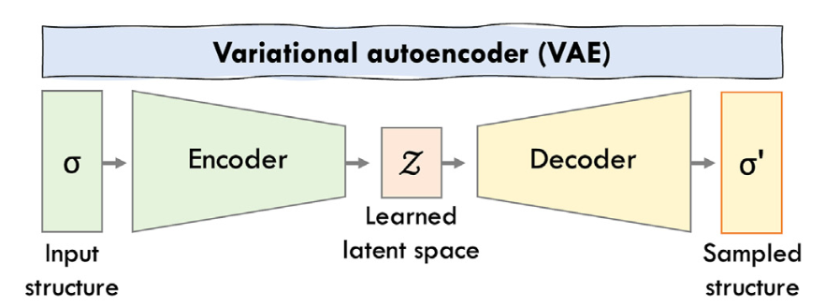
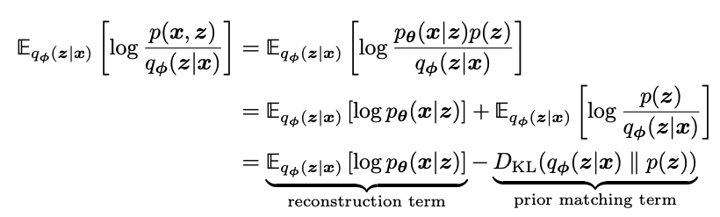
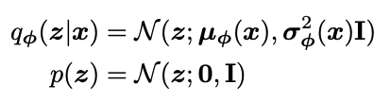

Diffusion model theory
Actually just derived loss-function for VAE’s
Where one typically chooses $p(z)$ and $q_{φ}(z∣x)$ as some approximation :
Decoder NN
Encoder NN

Slide 9
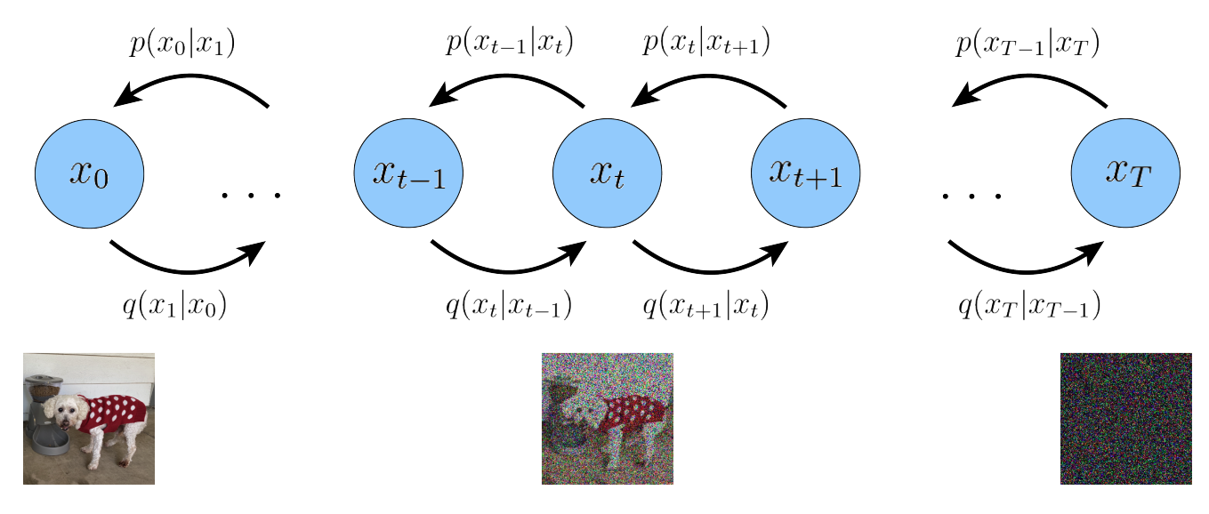
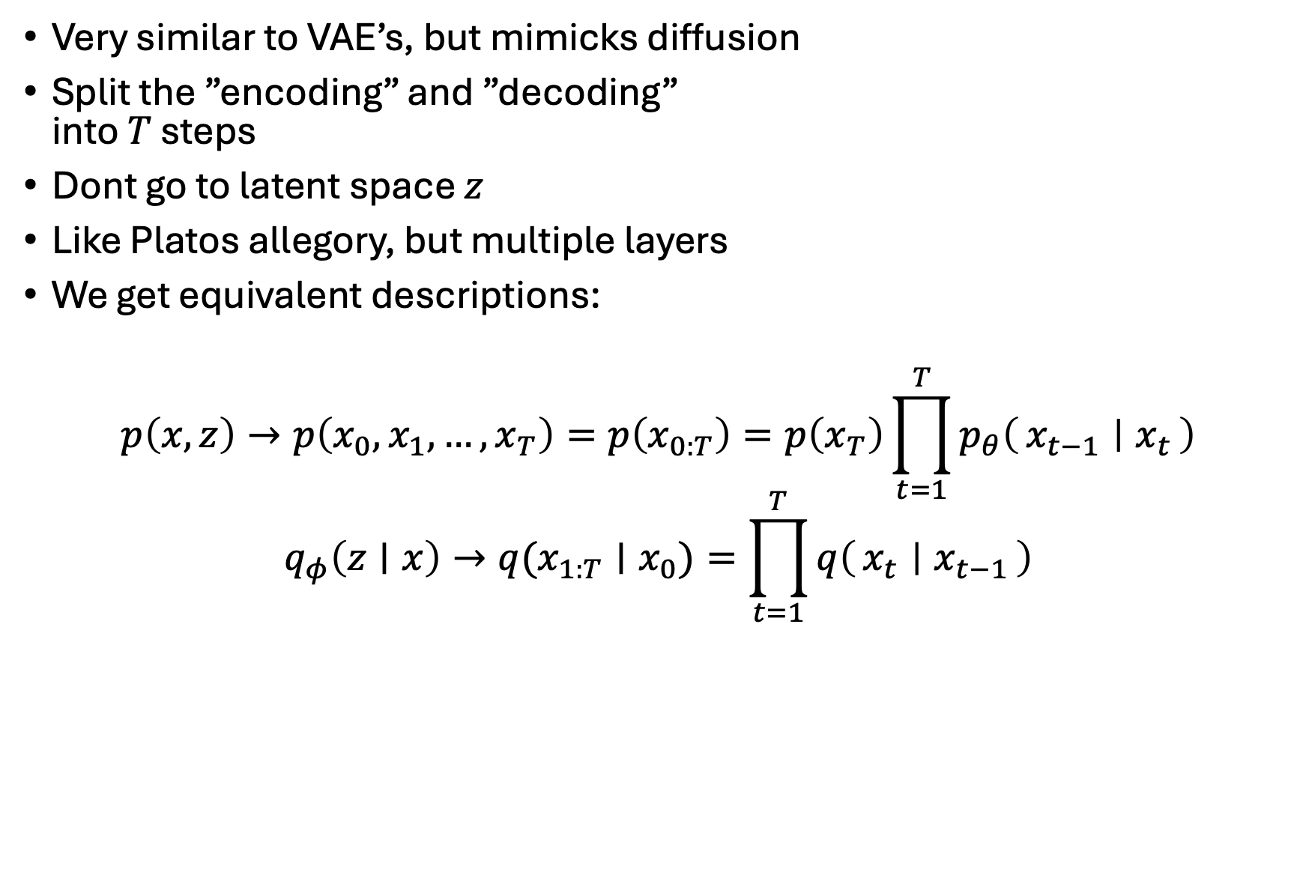
Diffusion model theory
Very similar to VAE’s, but mimicks diffusion
Split the ”encoding” and ”decoding” into $T$ steps
Dont go to latent space $z$
Like Platos allegory, but multiple layers
We get equivalent descriptions:
$$p\left(x,z\right)→p\left(x_{0},x_{1},…,x_{T}\right)=p\left(x_{0:T}\right)=p\left(x_{T}\right)\prod_{t=1}^{T}{p_{θ}\left(x_{t−1} ∣ x_{t}\right)}$$
$$q_{φ}\left(z∣x\right)→q(x_{1:T}∣x_{0})=\prod_{t=1}^{T}{q\left(x_{t} ∣ x_{t−1}\right)}$$

Slide 10

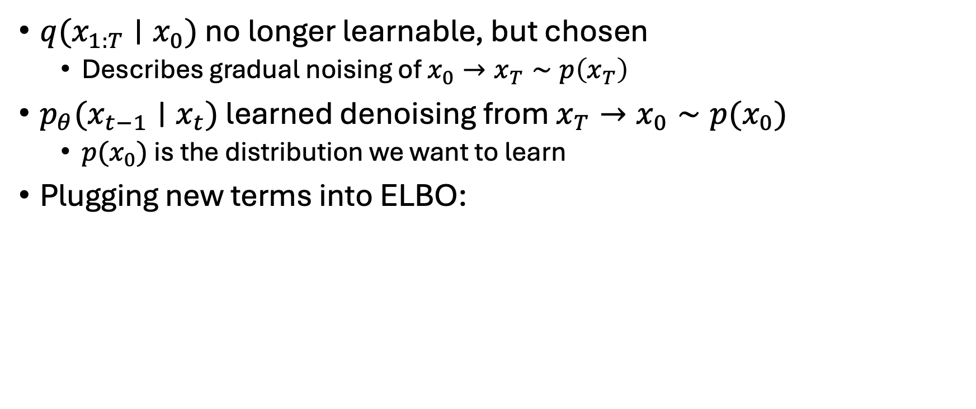
Diffusion model theory
$q(x_{1:T}∣x_{0})$ no longer learnable, but chosen
Describes gradual noising of $x_{0}→x_{T}∼p\left(x_{T}\right)$
$p_{θ}(x_{t−1}∣x_{t})$ learned denoising from $x_{T}→x_{0}∼p(x_{0})$
$p(x_{0})$ is the distribution we want to learn
Plugging new terms into ELBO:

Slide 11
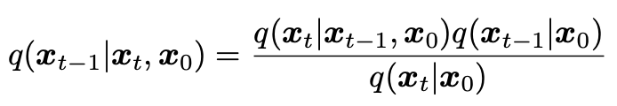
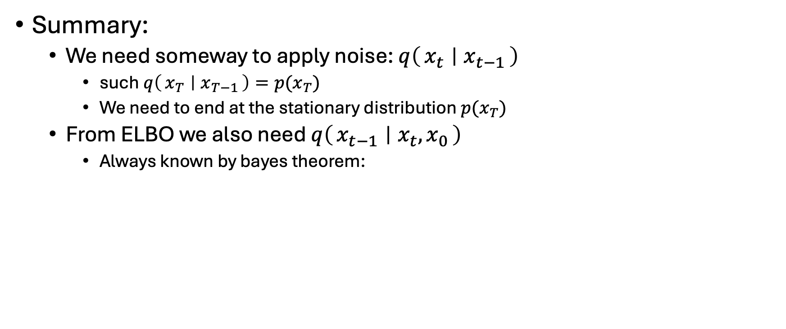
Diffusion model theory
Summary:
We need someway to apply noise: $q\left(x_{t} ∣ x_{t−1}\right)$
such $q\left(x_{T} ∣ x_{T−1}\right)=p(x_{T})$
We need to end at the stationary distribution $p(x_{T})$
From ELBO we also need $q\left(x_{t−1} ∣ x_{t},x_{0}\right)$
Always known by bayes theorem:

Slide 12
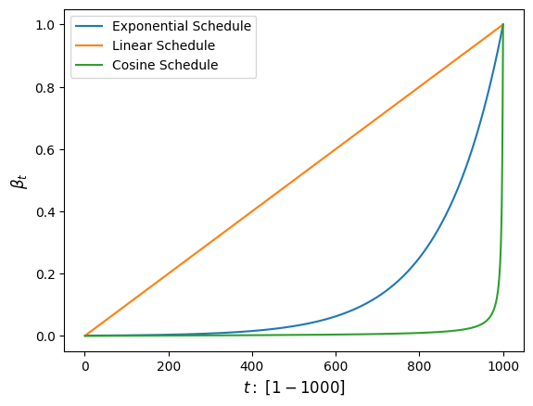
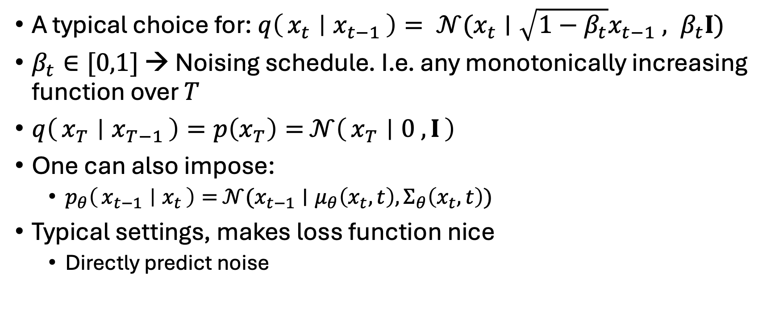
Diffusion model theory
A typical choice for: $q\left(x_{t} ∣ x_{t−1}\right)= 𝒩(x_{t}∣\sqrt{1−β_{t}}x_{t−1} , β_{t}I)$
$β_{t}∈[0,1]$ → Noising schedule. I.e. any monotonically increasing function over $T$
$q\left(x_{T} ∣ x_{T−1}\right)=p\left(x_{T}\right)=$ $𝒩\left(x_{T} ∣ 0 , I\right)$
One can also impose:
$p_{θ}\left(x_{t−1} ∣ x_{t}\right)=$ $𝒩(x_{t−1}∣μ_{θ}\left(x_{t},t\right), Σ_{θ}\left(x_{t},t\right))$
Typical settings, makes loss function nice
Directly predict noise

Slide 13

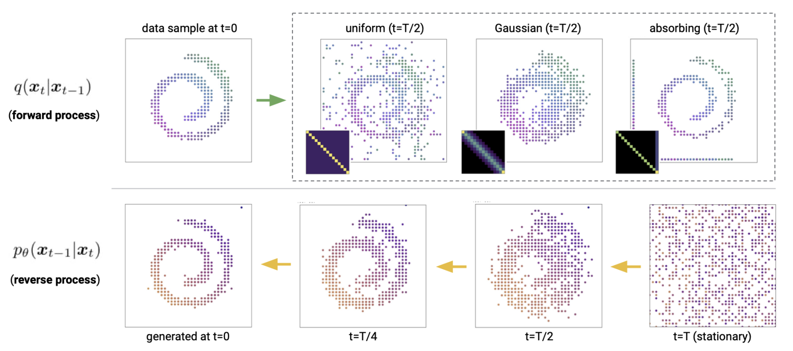

Back to our problem
We have diffusion over discrete states:
i.e. [”Rh”, ”Pd”, ”Au”, …] → [”Rh”, ”Au”, ”Ni”, …]
Gradual noising $q(x_{t}∣x_{t−1})$ is also categorical
Cannot use nice continous gaussian distributions?
Use implementation from paper

Slide 14


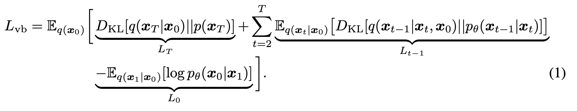
Back to our problem
Paper implements these transitions as:
Q-matrices govern the transfer between different categories
Element pool: [”Rh”, ”Pd”, ”Ni”, ”Au”]
The ”Rh” coloumn/row becomes:
[0.50, 0.20, 0.30, 0.10]
Loss becomes (regular ELBO):
0.50
Rh
0.20
Pd
0.30
0.10
Ni
Au

Slide 15
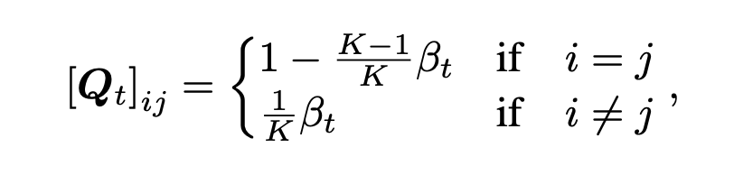
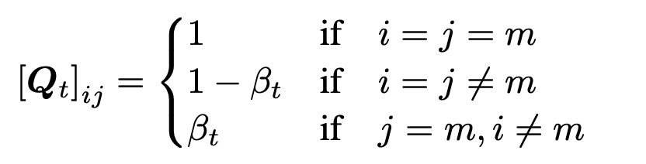
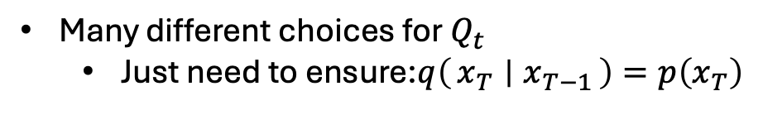
Q-matrices
Many different choices for $Q_{t}$
Just need to ensure:$q\left(x_{T} ∣ x_{T−1}\right)=p\left(x_{T}\right)$
Uniform transitions
Absorbing state formulation

Slide 16
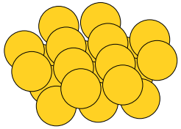
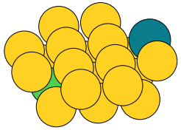
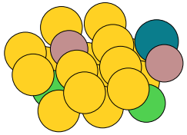
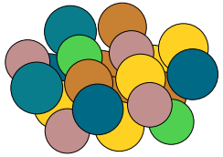
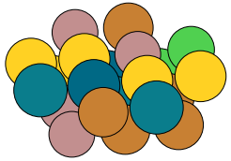
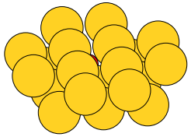
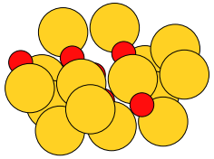
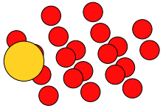
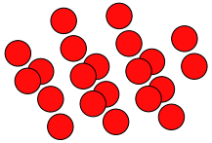










How i implemted this: Diffusion examples
Used Exponential schedule with $β_{t}∈\left[1{⋅10}^{−4},1{⋅10}^{−1}\right]$
Uniform diffusion; $x_{t}∼q(x_{t}|x_{t−1})$
$$t=\frac{T}{4}$$
$$t=\frac{T}{2}$$
$$t=\frac{3T}{4}$$
$$t=T$$
$$t=0$$
Absorbing diffusion; $x_{t}∼q(x_{t}|x_{t−1})$
$$t=\frac{T}{4}$$
$$t=\frac{T}{2}$$
$$t=\frac{3T}{4}$$
$$t=T$$
$$t=0$$

Slide 17











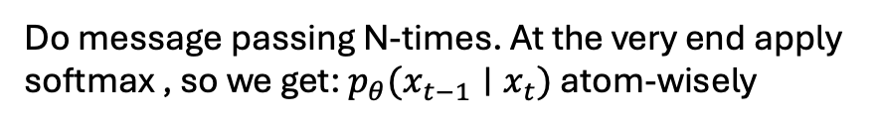



How I implemented this
Scheduling & forward diffusion already talked about
The denoising part: $p_{θ}\left(x_{t−1} ∣ x_{t}\right)$
A GNN using a fully learnable message-passing scheme.
Edges → Bonds
$$\left[\begin{matrix}0 \\ 0 \\ 1\end{matrix}\right]$$
$$\left[\begin{matrix}0 \\ 0 \\ 1\end{matrix}\right]$$
$$\left[\begin{matrix}1 \\ 0 \\ 0\end{matrix}\right]$$
$$\left[\begin{matrix}0 \\ 0 \\ 1\end{matrix}\right]$$
softmax
$$\left[\begin{matrix}0 \\ 0 \\ 1\end{matrix}\right]$$
$$\left[\begin{matrix}1 \\ 0 \\ 0\end{matrix}\right]$$
softmax
$$\left[\begin{matrix}1 \\ 0 \\ 0\end{matrix}\right]$$
$$\left[\begin{matrix}0 \\ 1 \\ 0\end{matrix}\right]$$
$$\left[\begin{matrix}1 \\ 0 \\ 0\end{matrix}\right]$$
$$\left[\begin{matrix}0 \\ 1 \\ 0\end{matrix}\right]$$
Do message passing N-times. At the very end apply softmax , so we get: $p_{θ}(x_{t−1}∣x_{t})$ atom-wisely
Generate $x_{t−1}∼p_{θ}(x_{t−1}∣x_{t})$
Input graph: $x_{t}$

Slide 18
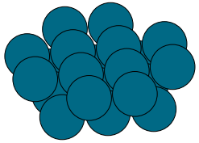
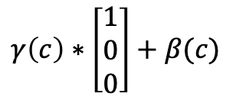
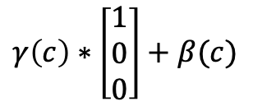
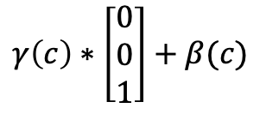

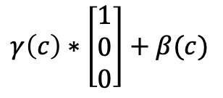
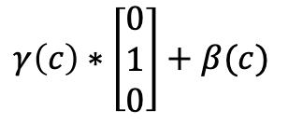
How I implemented this
As mentioned: Could be nice with guidance
Does not change anything in the derivations? Just $p_{θ}(x_{t−1}∣x_{t},c)$
For now only class labels → Embedded into learnable vector $c$
Additionally two MLPs: $γ\left(c\right), β(c)$ which sees the condition
Shifts the inputs of the GNN
$$γ\left(c\right)∗\left[\begin{matrix}1 \\ 0 \\ 0\end{matrix}\right]+β(c)$$
$$γ\left(c\right)∗\left[\begin{matrix}0 \\ 0 \\ 1\end{matrix}\right]+β(c)$$
Class 1: Pure Au
Class 2: Pure Pd
$$γ\left(c\right)∗\left[\begin{matrix}1 \\ 0 \\ 0\end{matrix}\right]+β(c)$$
Do message passing and softmax as shown earlier
$$γ\left(c\right)∗\left[\begin{matrix}1 \\ 0 \\ 0\end{matrix}\right]+β(c)$$
$$γ\left(c\right)∗\left[\begin{matrix}0 \\ 1 \\ 0\end{matrix}\right]+β(c)$$

Slide 19
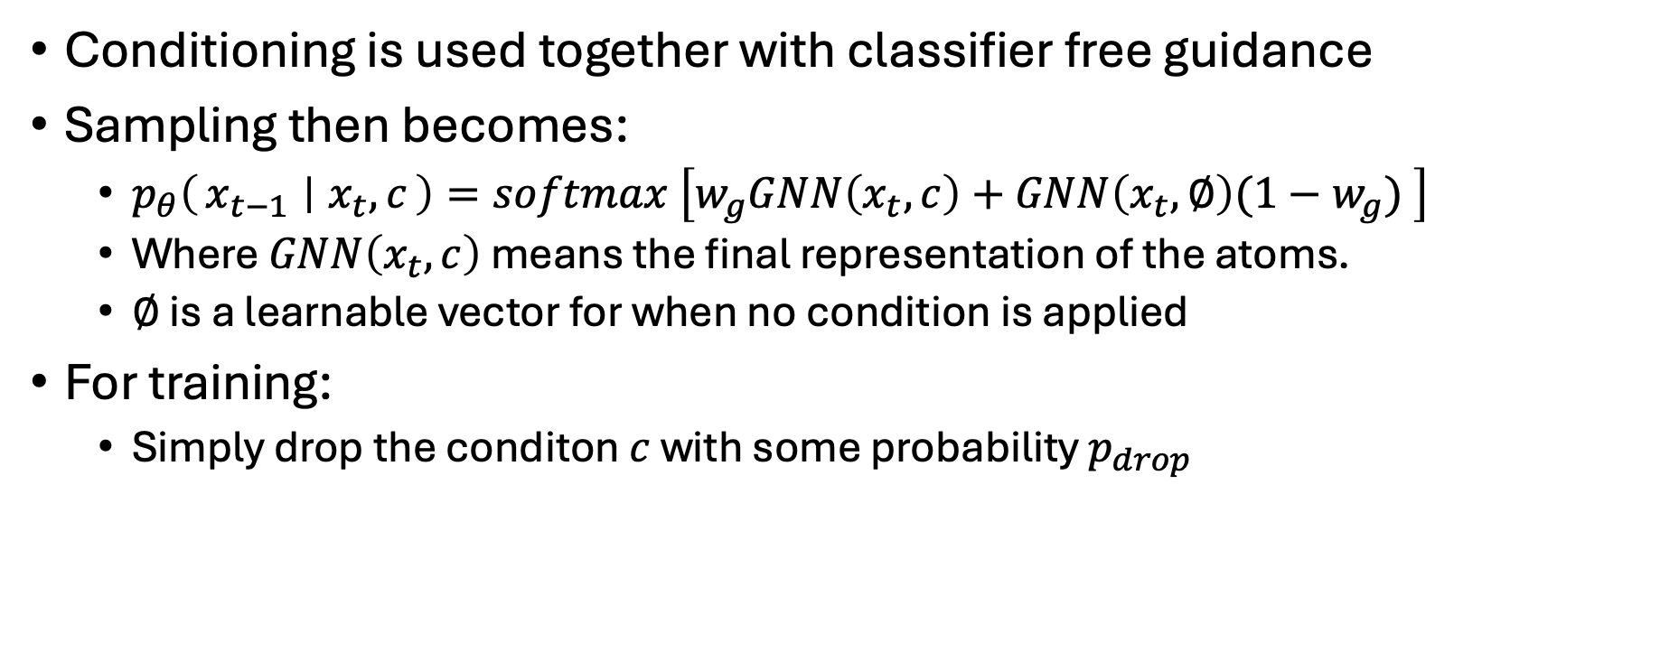
How I implemented this
Conditioning is used together with classifier free guidance
Sampling then becomes:
$p_{θ}\left(x_{t−1} ∣ x_{t},c\right)=softmax \left[w_{g}GNN\left(x_{t},c\right)+GNN\left(x_{t},∅\right)(1−w_{g}) \right]$
Where $GNN\left(x_{t},c\right)$ means the final representation of the atoms.
$∅$ is a learnable vector for when no condition is applied
For training:
Simply drop the conditon $c$ with some probability $p_{drop}$

Slide 20







Finally: Testing my implementation
Trial dataset: 400 structures 50:50 split between 2 classes
Blue atoms: Pd, Yellow atoms: Au
Set categorical space: $\left[Au, Pd, Rh, Ni, Ga, Cu\right]$
Using Classifier free guidance: Drop probability: 10%
1000 timesteps
Tried both Uniform transitions & Absorbing state
Training set
Class 1
Class 2
Class 1
Class 2
Class 1
Class 2

Slide 21

Finally: Testing my implementation
Absorbing state - Cosine time schedule: $β_{t}∈\left[1{∗10}^{−4};1{∗10}^{−1}\right]$
Guidance scale: 2.0
Conditioned on class 1
Conditioned on class 2

Slide 22

Finally: Testing my implementation
Uniform transitions - Cosine time schedule: $β_{t}∈\left[1{∗10}^{−4};2{∗10}^{−1}\right]$
Guidance scale: 2.0
Conditioned on class 1
Conditioned on class 2

Slide 23
What now?
Need to test it on ”real” structures
Maybe rate embedding alone is too ”weak”

